Slide 1
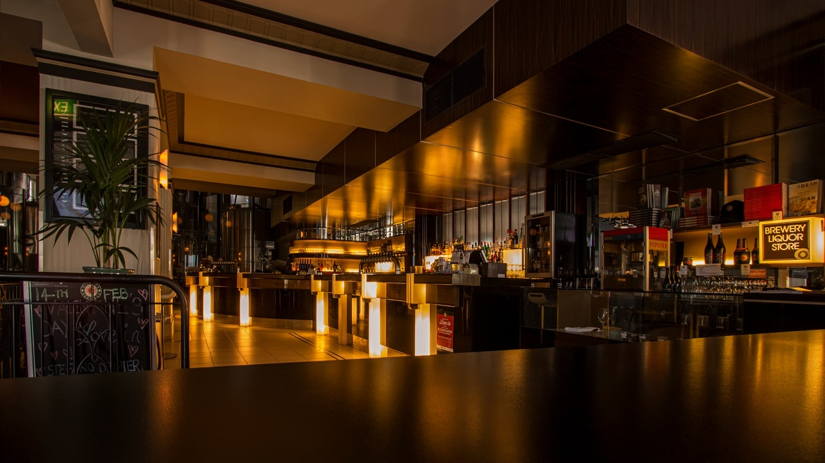

Effects of COVID-19 on the Service Industry
Ryan Grant

Slide 2
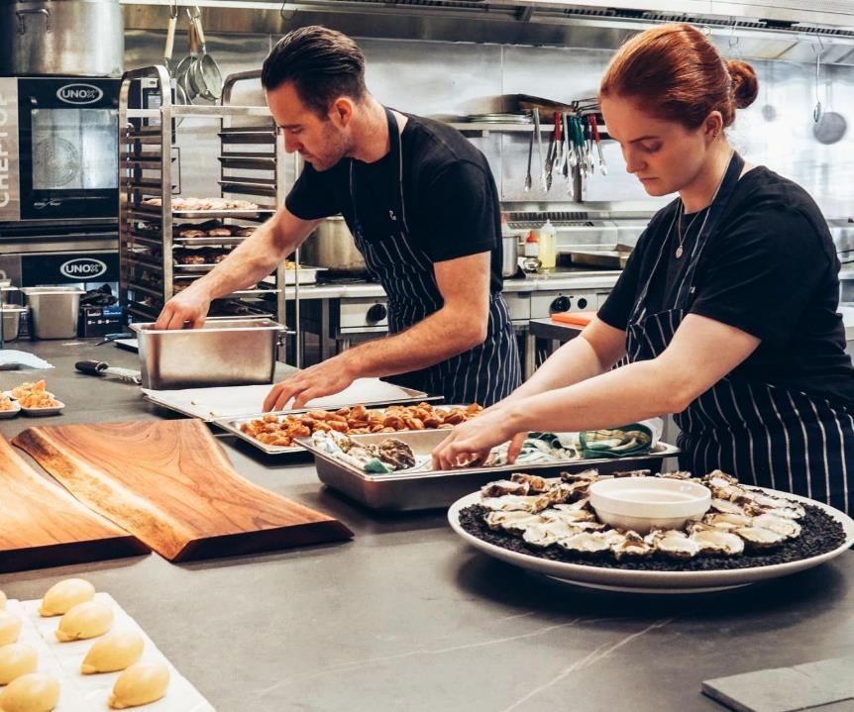


The State of the Industry
More than 110,000 restaurants and bars closed, either temporarily or Permanently.
2.5 Million jobs erased compared to pre-pandemic levels
Foodservice industry sales in 2020 fell by $240 billion from an expected $899 billion.

Slide 3

Comparison To “Stable” Industries?

Slide 4


Slide 6
Are Restaurant Workers Returning To Work?

Slide 10
Job Openings in Other Industries

Slide 11
THANK YOU
References
www.bls.gov
https://restaurant.org/home
https://www.yelp.com/

